Slide 1
Unit 6: Tree

Slide 2
CONTENTS
Introduction
Basic Operation in Binary tree
Tree Search and Insertion/Deletion
Binary Tree Traversals (pre-order, post -order and in-order)
Tree Height, Level, and Depth
Balanced Trees: AVL Balanced Trees, Balancing Algorithm
The Huffman Algorithm
Game tree
B-Tree.

Slide 3
Tree:
A tree is an abstract model of a hierarchical structure that consists of nodes with a parent-child relationship.
Tree is a sequence of nodes.
There is a starting node known as root node.
Every node other than the root has a parent node.
Nodes may have any number of children

Slide 4
Characteristics of trees:
✔ Non-linear data structure
✔ searching as fast as in ordered array
✔ insertion and deletion as fast as in linked list

Slide 5
Application:
✔ Directory structure of a file store
✔ Structure of arithmetic expressions
✔ Hierarchy of an organization

Slide 6
Some key terms:
Degree of a node:
The degree of a node is the number of children of that node.
In above tree the degree of node A is 3.
Degree of a Tree:
The degree of a tree is the maximum degree of nodes in a given tree.
In the above tree the node A has maximum degree, thus the degree of the tree is 3

Slide 7
Some key terms:
Path:
It is the sequence of consecutive edges from source node to destination node. There is a single unique path from the root to any node.
Height of a node:
The height of a node is the maximum path length from that node to the deepest leaf node. A leaf node has a height of 0.
Height of a tree:
The height of a tree is the height of the root.
Depth of a node:
Depth of a node is the path length from the root to that node. The root node has a depth of 0.
Depth of a tree:
Depth of a tree is the maximum level of any leaf in the tree.
This is equal to the longest path from the root to any leaf.

Slide 8
Some key terms:
Level of a node:
The level of a node is 0, if it is root; otherwise it is one more then its parent
Example
A is the root node
✔ B is the parent of E and F
✔ D is the sibling of B and C
✔ E and F are children of B
✔ E, F, G, D are external nodes or leaves
✔ A, B, C are internal nodes
✔ Depth of F is 2
✔ the height of tree is 2
✔ the degree of node A is 3
✔ The degree of tree is 3

Slide 9
Binary Trees:
A binary tree is a finite set of elements that are either empty or is partitioned into three disjoint subsets.
The first subset contains a single element called the root of the tree. The other two subsets are themselves binary trees called the left and right sub-trees of the original tree.
A left or right sub tree can be empty.
Each element of a binary tree is called a node of the tree. The following figure shows a binary tree with 9 nodes where A is the root

Slide 10
Binary tree properties:
✔ If a binary tree contains m nodes at level l, it contains at most 2m nodes at level l+1.
✔ Since a binary tree can contain at most 1 node at level 0, it contains at most 2l nodes at level l.
Types of binary tree
✔ Complete binary tree
✔ Strictly binary tree
✔ Almost complete binary tree

Slide 11
Strictly binary tree:
If every non-leaf node in a binary tree has nonempty left and right sub-trees, then such a tree is called a strictly binary tree.

Slide 12
Complete binary tree:
A binary tree of depth d is called complete binary tree if all of whose leaves are at level d.
A complete binary tree with depth d has 2^{d} leaves and 2^{d} -1 non-leaf nodes (internal)

Slide 13
Almost complete binary tree:
A binary tree of depth d is an almost complete binary tree if:
✔Each leaf in the tree is either at level d or at level d-1

Slide 14
Binary tree is called almost complete binary tree if the array representation has not any null value within the allocated area
A | B | C | D | E | F | G | H | I | J

Slide 15
Operation on Binary Tree
Father (n,T)→ returns the parent node of the node in Tree
Leftchild(n,T)→ returns left child node
Rightchild(n,T)→ returns right child node
Info(n,T): Return information stored in node n of tree T (ie. Content of a node).
Sibling(n,T): return the sibling node of node n in tree T. Return NULL if n has no sibling.
Root(T): Return root node of a tree if and only if the tree is nonempty.
Size(T): Return the number of nodes in tree T
MakeEmpty(T): Create an empty tree T
SetLeft(S,T): Attach the tree S as the left sub-tree of tree T
SetRight(S,T): Attach the tree S as the right sub-tree of tree T.
Preorder(T): Traverses all the nodes of tree T in preorder.
postorder(T): Traverses all the nodes of tree T in postorder
Inorder(T): Traverses all the nodes of tree T in inorder

Slide 16
Binary Tree Representation
Linked Representation
Sequential Representation

Slide 17
Linked representation
In this representation the tree is stored in memory in the form of linked list.
Every node contains three part: pointer to the left node, pointer to the right node and data element
Each binary tree has a root pointer that points the root of the tree

Slide 18
Structure of Binary tree:
struct bnode
{
int info;
struct bnode *left;
struct bnode *right;
};
struct bnode *root=NULL;

Slide 19
Sequential Representation
This is a simple memory allocation technique to store the tree elements.
This is in efficient since it require lots of space to store a tree
A | B | C | D | E | F | G | H | I | J

Slide 20
Binary tree traversal techniques
The tree traversal is a way in which each node in the tree is visited exactly once in a symmetric manner.
There are three popular methods of traversal
✔ Pre-order traversal
✔ In-order traversal
✔ Post-order traversal

Slide 21
Pre-order traversal:
The preorder traversal of a nonempty binary tree is defined as follows:
✔ Visit the root node
✔ Traverse the left sub-tree in preorder
✔ Traverse the right sub-tree in preorder
The preorder traversal output of the given tree is: A B D H I E C F G
The preorder is also known as depth first order

Slide 22
C function for preorder traversing:
void preorder(struct bnode *root)
{
if(root!=NULL)
{
printf(“%c”, root->info);
preorder(root->left);
preorder(root->right);
}
}

Slide 23
In-order traversal:
The in-order traversal of a nonempty binary tree is defined as follows:
✔ Traverse the left sub-tree in in-order
✔ Visit the root node
✔ Traverse the right sub-tree in in-order
The in-order traversal output of the given tree is: H D I B E A F C G

Slide 24
C function for in-order traversing:
void inorder(struct bnode *root)
{
if(root!=NULL)
{
inorder(root->left);
printf(“%c”, root->info);
inorder(root->right);
}
}

Slide 25
Post-order traversal:
The post-order traversal of a nonempty binary tree is defined as follows:
✔ Traverse the left sub-tree in post-order
✔ Traverse the right sub-tree in post-order
✔ Visit the root node
The post-order traversal output of the given tree is: H I D E B F G C A

Slide 26
C function for post-order traversing:
void post-order(struct bnode *root)
{
if(root!=NULL)
{
post-order(root->left);
post-order(root->right);
printf(“%c”, root->info);
}
}

Slide 27
Binary search tree(BST):
A binary search tree (BST) is a binary tree that is either empty or in which every node contains a key (value) and satisfies the following conditions:
✔ All keys in the left sub-tree of the root are smaller than the key in the root node
✔ All keys in the right sub-tree of the root are greater than the key in the root node
✔ The left and right sub-trees of the root are again binary search trees

Slide 28
BST
Given the following sequence of numbers,
14, 15, 4, 9, 7, 18, 3, 5, 16, 4, 20, 17, 9, 14, 5
The following binary search tree can be constructed:

Slide 29














BST
14, 15, 4, 9, 7, 18, 3, 5, 16, 4, 20, 17, 9, 14, 5

Slide 30
Advantage of BST
Searching becomes very efficient, we get hint at each step about which subtree contains the desired element
In the process of searching, it removes half subtree at every step

Slide 31
Operations on Binary search tree(BST):
Following operations can be done in BST:
✔ Search(k, T): Search for key k in the tree T. If k is found in some node of tree then return true otherwise return false.
✔ Insert(k, T): Insert a new node with value k in the info field in the tree T such that the property of BST is maintained.
✔ Delete(k, T): Delete a node with value k in the info field from the tree T such that the property of BST is maintained.
✔ FindMin(T), FindMax(T): Find minimum and maximum element from the given nonempty BST.

Slide 32
Searching in BST
Problem: Search for a given target value in a BST.
Idea: Compare the target value with the element in the root node.
If the target value is equal, the search is successful.
If target value is less, search the left subtree.
If target value is greater, search the right subtree.
If the subtree is empty, the search is unsuccessful

Slide 33
BST search algorithm :
To find which if any node of a BST contains an element equal to target:
1. Set curr to the BST’s root.
2. Repeat:
2.1. If curr is null:
2.1.1. Terminate with answer none.
2.2. Otherwise, if target is equal to curr’s element:
2.2.1. Terminate with answer curr.
2.3. Otherwise, if target is less than curr’s element:
2.3.1. Set curr to curr’s left child.
2.4. Otherwise, if target is greater than curr’s element:
2.4.1. Set curr to curr’s right child.
3. end

Slide 34
C function for BST searching:
void BinSearch(struct bnode *root , int key)
{
if(root == NULL)
{
printf(“The number does not exist”);
exit(1);
}else if (key == root->info)
{
printf(“The searched item is found”):
}else if(key < root->info)
return BinSearch(root->left, key);
else
return BinSearch(root->right, key);
}

Slide 35
Insertion of a node in BST:
To insert a new item in a tree, we must first verify that its key is different from those of existing elements.
To do this a search is carried out. If the search is unsuccessful, then item is inserted.
To insert a new element into a BST, proceed as if searching for that element. If the element is not already present, the search will lead to a null link. Replace that null link by a link to a leaf node containing the new element.

Slide 36
Insert a new node

Slide 37
BST insertion algorithm :
Start
Allocate the memory for the tree
Set the data part to the value and set the left and right pointer of tree point to NULL
If the item to be inserted will be the first element of the tree, then the left and the right of the node will point the NULL
Else, check if the item is less than the root element of the tree
if this is true, then recursively perform this operation with the left of the root
If this is false then perform this operation recursively with the right sub tree of the root
Stop

Slide 38
C function for BST insertion:
void insert(struct bnode *root, int item)
{
if(root=NULL)
{
root=(struct bnode*)malloc (sizeof(struct bnode));
root->left=root->right=NULL;
root->info=item;
}else
{
if(item<root->info)
root->left=insert(root->left, item);
else
root->right=insert(root->right, item);
}
}

Slide 39
Insert 95 to the BST
A[]= 50, 25,75,12,30,85,60,52,70

Slide 40
Deleting a node from the BST
While deleting a node from BST, there may be three cases:
1. The node to be deleted may be a leaf node:
In this case simply delete a node and set null pointer to its parents those side at which this deleted node exist

Slide 41
2. The node to be deleted has one child:
In this case the child of the node to be deleted is appended to its parent node. Suppose node to be deleted is 18

Slide 42
3. the node to be deleted has two children:
In this case node to be deleted is replaced by its in-order successor node OR
the node to be deleted is either replaced by its right sub-trees leftmost node or its left sub-trees rightmost node.

Slide 43
General algorithm to delete a node from a BST:
1. start
2. if a node to be deleted is a leaf node at left side then simply delete and set null pointer to it's parent's left pointer.
3. If a node to be deleted is a leaf node at right side then simply delete and set null pointer to it's parent's right pointer
4. if a node to be deleted has on child then connect it's child pointer with it's parent pointer and delete it from the tree
5. if a node to be deleted has two children then replace the node being deleted either by
a. right most node of it's left sub-tree or
b. left most node of it's right sub-tree.
6. End

Slide 44
Huffman Algorithm

Slide 46
Let us take any four characters and their frequencies, and sort this list by increasing frequency.
Since to represent 4 characters the 2 bit is sufficient thus take initially two bits for each character this is called fixed length character.
Character | Frequencies
A | 03
T | 07
E | 10
O | 05

Slide 47
Arrange characters according to their frequency in increasing order
Character | Frequencies | Code
A | 03 | 00
O | 05 | 01
T | 07 | 10
E | 10 | 11

Slide 48
Here before using Huffman algorithm the total number of bits required is
nb=3*2+5*2+7*2+10*2=06+10+14+20=50bits

Slide 49
Using Huffman Algorithm

Slide 51
Now from variable length code we get following code sequence.
character frequencies code
Thus after using Huffman algorithm the total number of bits required is
nb=3*3+5*3+7*2+10*1=09+15+14+10=48bits
(50-48)/50*100%=4%
Since in this small example we save about 4% space by using Huffman algorithm. If we
take large example with a lot of characters and their frequencies.
Character | Frequencies | Code
A | 03 | 110
O | 05 | 111
T | 07 | 10
E | 10 | 0

Slide 52
AVL Tree
Invented by GM Adelson-Velsky and EM Landis
Also called height balanced binary search tree in which each node is associated with a balance factor which is calculated by subtracting the height of its right subtree from the left subtree
The tree is said to be balanced if the balance factor of each node is equal to -1 to 1, otherwise the tree will be unbalanced and needs balancing
Balance factor (k)= height of left subtree – height of right sub tree
If k= 1, it means the left subtree is one level higher than right subtree
If k=0, it means height of both sub tree is same
If k=1, the right subtree is one level higher

Slide 53
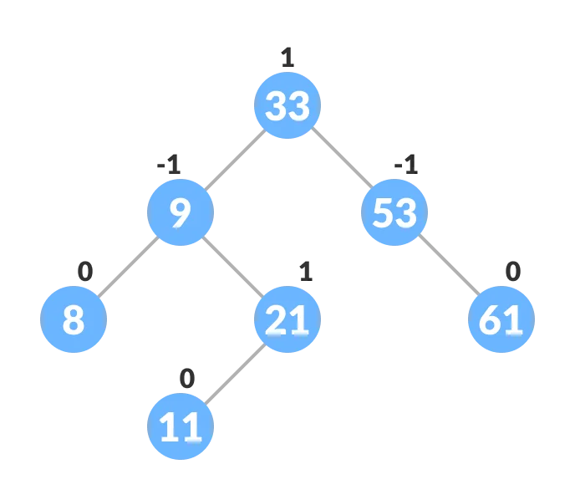
AVL tree

Slide 54
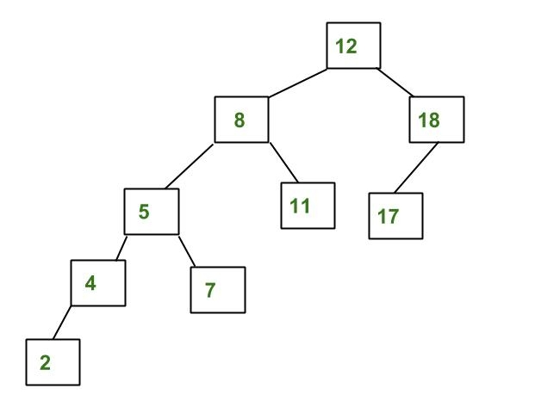
Non AVL Tree

Slide 55
How to make non AVL tree to AVL tree
The following four kind of rotation is performed to balance the AVL tee
Left rotation
Right rotation
Left – right rotation
Right – left rotation

Slide 56
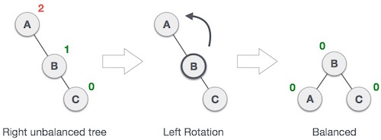
Left rotation
If tree becomes unbalance upon inserting node in the right side left rotation is performed

Slide 57
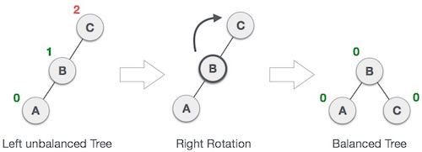
Right rotation
AVL tree may become unbalanced, if a node is inserted in the left subtree of the left subtree. The tree then needs a right rotation.

Slide 58
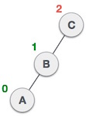

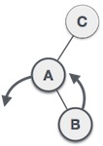
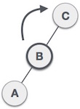
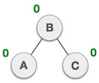
Left-Right Rotation
A left-right rotation is a combination of left rotation followed by right rotation.

Slide 59

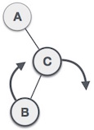
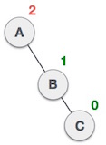
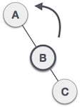
Right-Left Rotation
The second type of double rotation is Right-Left Rotation. It is a combination of right rotation followed by left rotation.

Slide 60
AVL tree continue…..
Construct the AVL tree by inserting the following elements in the given order
A[]= {63,9,19,27,18,108,99,81}
A[]= {3,5,11,8,4,1,12,7,2,6,10}

Slide 61
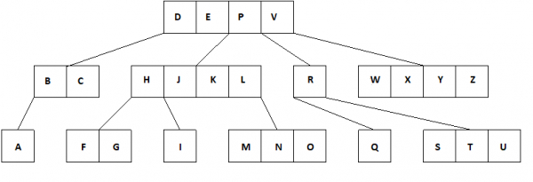
Multiway tree
A multiway tree is a tree that can have more than two children
A multiway tree of order m or an m way tree is one in which a tree can have m children
Multiway tree of order m will have m key fields

Slide 62
Features of m-way tree
Each node can have m children and m- keys
Keys in each node are in ascending order

Slide 63
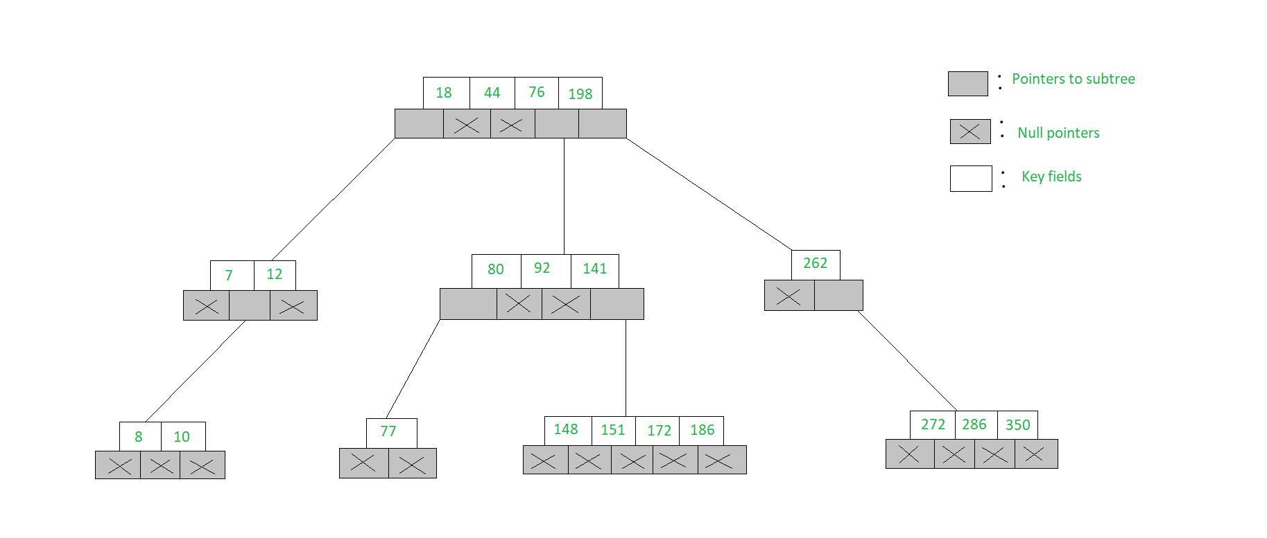
Features of m-way tree

Slide 64
B-tree
It is a special m-way tree which can have at most m-1 keys and m children
A B tree of order m contains all properties of m tree and in addition contains the following property
Every node in a B-tree contains at most m children
Every node in B tree except root node and the leaf node contains at least n/2 children
Root node must have at least 2 child nodes
All the leaf node must be at the same level

Slide 65
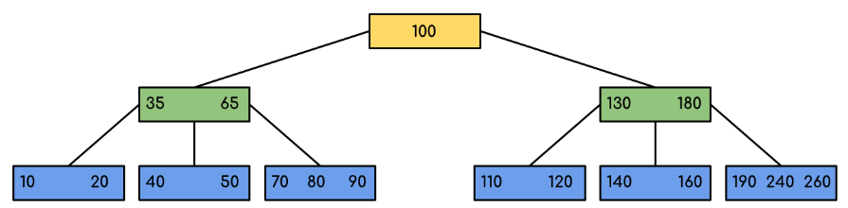
B-tree

Slide 66
The End

